Slide 1
Journey of GeM

Slide 2
Multiple issues existed in Indian public procurement till 2016
Limitations and inefficiencies in procurement system
Time consuming and manual processes
Multi-pronged and complex procurement guidelines
Manual interventions leading to high turnaround time
General Financial Rules for central buyers, different norms for each state
Localized supplier base
Varying prices across bids of similar products
Administrative overheads for public buying organizations
Other policies such as MSME's, Make in India and line ministry guidelines
In-silo buying with no option of demand pooling
Potential collusion risk with manual rate negotiations
Spend reservation for specific goods, e.g., Khadi
1. DGS&D refers to Directorate General of Supplies and Goods

Slide 3
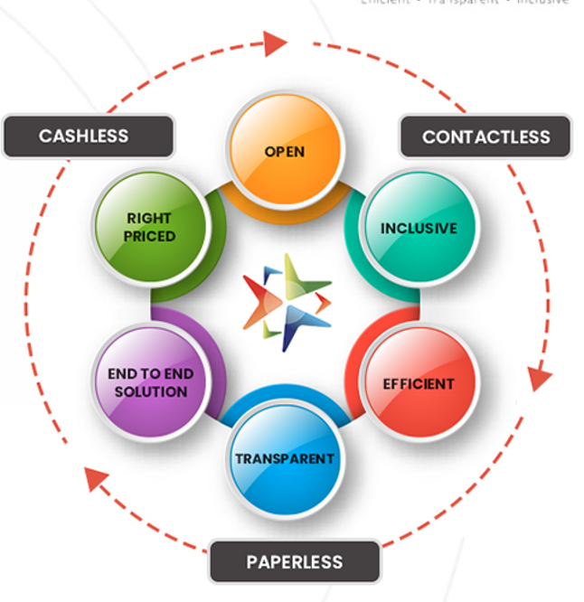
The Genesis: Government e-Marketplace (GeM) setup in 2016
One-stop online procurement portal for all Central and State Ministries, Departments, Bodies & PSUs
Rule 149 of the GFR amended, mandating the procurement of Goods and Services from GeM for all the Central Ministries and Departments
Multiple tools enabled for public procurement: Direct purchase, L1, Bid / Reverse Auction, and Forward Auction
Commitment to Three pillars: Efficiency, Transparency & Inclusiveness in public procurement

Slide 4
Business overview | Breaching the ₹ 1.75 lakh crore mark in record time
Strong growth trajectory…
…with contribution across buyer segments
Gross Merchandise Value (GMV), ₹ crore
Buyer Category | GMV (₹ crore)
Buyer Category | FY20-21 | FY21-22 | FY21-22 (1st Apr-20th Mar) | FY22-23 (1st Apr-20th Mar)
Central Ministries | 14,358 | 29,309 | 26,942 | 49,246
CPSEs | 7,027 | 45,958 | 42,176 | 94,142
States | 17,188 | 31,280 | 28,533 | 38,719
TOTAL | 38,573 | 1,06,547 | 97,651 | 1,82,107
86%
Since its inception, GeM has processed orders worth more than ₹ 3.7 lakh crore
Source: GeM Transactions and Finance data

Slide 5
Consistent growth in Buyer and Seller ecosystem
Growth of buyer organizations on GeM
Growth of sellers and service providers on GeM**
Description | FY21 | FY22 | FY23 (till 20th Mar’23)
Average Order Value Per Day (₹ crore) | 69 | 292 | 514
Average No. of Orders Per Day | 5,337 | 9,086 | 13,306
Average No. of Bids/RA Per Day | 1,824 | 1,913 | 2,482
**: From FY 21 , figures of sellers has increased drastically due to integration of GeM with Udyam portal. Present active sellers are ~14 lakh and GeM has taken up aggressive outreach through CSC and Post Offices to complete registration formalities for the provisionally registered sellers extracted through Udyam portal.
Source: GeM Transactions and Finance data

Slide 6
Catalogue Management System | Overview
CMS is the framework that operationalizes “Brand Independence” & “Price Legacy/reasonability”.
CMS provides:
Open, global, multi-sector standard for efficient, accurate classification of products and services
Unambiguous Specification of product and services for accurate product identification and comparison
Product/ Service Registration
Search engine
Price Monitoring
Key Features in CMS:
Categorization: UNSPSC
Category Management: Search category; Add new category; Manage category configuration, Technical Parameters, Usage Definitions
Technical Product / Service Specification: A well-defined property set (parameters) with value sets identifying a category of product/ service
Built on a Data Model which is flexible (to cater to the diverse categories) and structured (easily interpreted and validated). e.g., Enumerable, Numeric, Boolean, Text, Date etc.
Process: Work with OEMs/ Sellers/ Service providers to identify the latest/standard products and service configurations; Derive the generic property set with value sets that best define the products/ services in category

Slide 7
Catalogue Management System | Products
1
Category Management:
Category Configuration: UOM, Buying Mode, MII component, Certifications, Pre-bid Enablement, etc.
Category TPs: Golden Parameters (with Rules like Higher/Lower Better etc) and others; Category Quadrants: Q1 to Q4
Catalogue Creation:
Search Category; Search Brand/ Apply for Brand
Feed Golden Parameters Value Set/ Pair existing catalogue
Provide Bid No., if any, for priority Product Approval
If country of origin is India, MII content to be provided
Packaging photo, Product Brochure, GSTIN Invoice, Import Documents, MRP Declaration on OEM Letterhead
Declare Stock quantity deliverable in 15 days; MOQ; Lead time for Direct Purchase
Set Delivery Location: Zone, State, District, Pin code
Catalogue Approval:
Catalogue approval team approves/rejects/notifies the catalogue as per the Queue algorithm
Check Make, Model of catalogue, MRP documents, Catalogue document, Catalogue image, Catalogue specification
OEM Panel/ Brand Approval:
OEM Panel Eligibility: VA Done or Qualifies for VAE
Brand Approval: Registered (TM) / Unregistered (Undertaking Stamp Paper)/ Unbranded
2
3
4

Slide 8
Catalogue Management System | Services
1
Category Management:
Category Configuration: Buying Mode, Certifications, Pre-bid Enablement etc.
Category Specifications
Catalogue Creation:
Service Providers can Search Category; Broadcast Services; Rate Sheets etc.
Feed Government Experience, Rate Sheet, Relevant Certificates, Price on Demand Categories
Set Service Delivery Location: Zone, State, District, Pin code
Catalogue Approval:
Verifying Agency (QCI) approves/rejects/notifies the catalogue as per the Queue algorithm
Check Experience Documents, Certifications
2
3

Slide 9
E-Procurement | Various e-procurement methods offered by GeM
Direct Purchase
Push Button Procure-ment
L1
Bid/RA
Intent of Buying -PAC
For amount less than INR 25,000
For amount up to INR 5 Lakh
For amount greater than INR 25,000/- and less than INR 5 Lakhs
Procurement via Bid/RA to get the best price quote
Procurement of specific product as per requirement is also possible
Other
features
Demand Aggregation
Custom
Bids
Forward Auction
BoQ Bids
Buyback

Slide 10
E-Procurement | Direct Purchase
Forward Auction Creation
Direct Purchase enables a buyer to buy products of value up to Rs. 25,000 which meet the requisite quality, specifications and delivery period, without comparison, through any of the available sellers on GeM
The Direct Purchase of a product can be done once in a week by buyer (except COVID categories)
The INR 25K limit is overruled in Automobile and some Drugs categories
The cart limit is 50 items and it remains active for 10 days
The 'Add to Cart' can be done by either Buyer or Indenter user role
Proceeding from Cart, Demand gets generated which also has a validity of 10 days
The buyer uploads the Financial Approval on Demand page
The buyer blocks fund, in case buyer organisation has opted PFMS/ GPA/ IFMS as payment mode
For several ERPs data is sent through integrated API

Slide 11
E-Procurement | Push Button Procurement
Forward Auction Creation
The total procurement value of purchase is not to exceed INR 5 lakh, inclusive of all taxes
This method can be used only if at least five bids are received. In case less than five bids are received, the procurement is to restart using usual procurement methods
No splitting of requirement can be done so as to bring procurement under this method

Slide 12
E-Procurement | L1 Purchase
Forward Auction Creation
L1 procurement enables direct purchase for order values between INR 25,000 and INR 5 Lakhs
Buyer needs to compare three different OEMs on GeM, who meet the requisite quality, quantity, specifications and delivery period demand
System will then recommend an L1 product matching these requirement. Buyer needs to select system recommended L1 to place a direct purchase order

Slide 13
E-Procurement | Bids and Reverse Auction
Forward Auction Creation
The Bidding/Reverse Auction mode shall allow buyers to conduct an electronic bid for the goods and services on the platform
Creation of bid documents as well as system driven evaluation will be driven through well-defined and standardized technical parameters and the bid terms and conditions
General Terms and Conditions, Special Terms and Conditions and Additional Terms and Conditions provided by the platform address the general requirements for floating e-bids/RA on GeM

Slide 14
E-Procurement | Participation methods in Bidding / Reverse Auction
Forward Auction Creation
GeM system has the provision to publish and participate bids in following ways:
Category based bidding: Buyer requires to select category/product with technical parameter associated with it. Seller can only participate if seller requirements matches with buyer specifications
Custom Bidding: Only allowed for the product not available on GeM
Availability report MUST be generated
Selection of 3 nearest categories
Seller submits the bid matching the custom catalogue
BOQ based bidding: Number of the line items are large
Enable Buyer to analyze Item wise Price breakup in a larger contract/project
Option to upload BOQ(s) (Bill of Quantities) against an item or multiple Items
Sellers quote prices for each Sub Item in the required BOQ format

Slide 15
E-Procurement | Bid Evaluation Methods
Forward Auction Creation
Total Value wise:
L1 will be determined on the overall cost of the items
Item wise-Schedule wise:
Seller has the choice to participate in a single or multiple items and then after L1 will be determined for individual items
Item wise-Consignee wise:
Seller has the option to offer prices for an item at different locations. It helps buyer to get best value because some sellers may be more competitive on some consignee locations.
Group Wise: Buyer has the choice to combined items/schedule in a group and then L1 determined based on the items available with group

Slide 16
E-Procurement | Bid Participation
Forward Auction Creation
System triggered notification
Provision of bid representation
CMS driven validations
Seller participate in the Bid and submit his technical and financial Bid before the Bid Closing Time.
Technical Offer: Seller chooses product he has offered in the market that are matching the buyer's requirement specification based on the golden parameters
Seller Offer: Seller offers unit price for each item. Once price has been entered, the total value based on the quantity should be displayed to the User
Document Upload: The seller should be required to upload all documents as per requirement of the Bid

Slide 17
E-Procurement | Ongoing Representations
Forward Auction Creation
Buyers can add terms and conditions in a Bid in the form of an ATC, Corrigendum, Scope of work (if made available for a category), Drawings, etc. These terms are published in the Bid document and are made available for all prospective sellers
Sellers can raise representation from the predefined categories
Buyers cannot open the technical Bids unless all representations have been responded to
Buyer must record his last reply at least 24 hours before bid end date and time
No representations will be allowed in last 72 hours of the Bid end date and time
If buyer records his last reply with only 24 hours or less remaining for the Bid to end or after Bid End Date, Bid will have to be extended by 48 hours minimum (buyer can also increase it) from the action date time. Only then buyer can proceed with Bid opening. Buyer will be prompted by system while submitting the response. If the buyer himself does not extend, system would auto extend by 48 hours

Slide 18
E-Procurement | Fulfilment and onwards (I/II)
Forward Auction Creation
Seller Action
The seller to pay transaction charge, if applicable, for the order
System generates an e-Invoice through GSTIN for invoice transaction charge
Seller can download ePBG format and proceed on PBG through bank; They then upload the PBG acknowledge on the GeM platform
The seller to fill all the mandatory fields on the invoice form, for invoice generation
The seller to do eSign/ DSC for final submission of invoice
The seller to provide Date of Delivery with proof, so that PRC/ CRAC can be created
PRC (Provisional Receipt Certificate) process
PRC generated within 4 days from seller proof of delivery updates
2 more days for editing/ verification of system generated PRC

Slide 19
E-Procurement | Fulfilment and onwards (II/II)
Forward Auction Creation
CRAC (Consignee Receiving & Acceptance Certificate) process
CRAC to be generated within a predefined timeframe
Configurable auto-CRAC generation timeline subject to certain conditions being met
The system gives 3 more days for editing/ verification of system generated CRAC, in case the consignee does not do it manually
The seller can raise supplementary/ rectification invoice of rejected quantity during CRAC

Slide 20
E-Procurement | Services on GeM – overview
1
Introduced “Services” as a Proof-of-Concept with a single service (Vehicle Hiring Services)
Benefits of Procuring Services on GeM
Category based procurement of service enables buyer to have better price discovery from broad range of service providers
Pre-identified critical technical specifications with flexibility of customization
ATC library available for addition of terms and conditions
Option to provide multiple consignee locations and quantity
Provision for Buyer adding buyer specific SLA, scope of work and T&C
Unique features available for Services
Each service has its own Specifications, SLA and STCs. Buyer can add ATC
GeM suggests two basic pre-qualification requirements: Turnover and Project Experience during creation of bid
Method of Evaluation: L1, LCS, QCBS
2
The Direct Purchase of a product can be done once in a week by buyer except covid categories.
The 25K limit is overruled in Automobile and some Drugs categories.
3

Slide 21
E-Procurement | Forward Auction Overview
Facilitates pan-India auction of categories of goods/ material/ immovable items
FA Sellers/ Auctioneers: Central and State Government Ministries /Departments, CPSUs & SPSUs, Autonomous Institutions and Local Bodies
GeM Buyer gets auto-registered as FA Seller/Auctioneer on Forward Auction Module
Facilitate auction & procurement in single platform
Forward Auction Categories:
E-waste: Electronic and Electrical
Land/Building: Industrial, Commercial and Residential
Machineries: Electric Industrial, Non-Electric Industrial
Scrap/Disposables: Lube/Waste Oil, Metallic, Non-Metallic, Useable and Scrap Vehicles
Others: Items for re-use and are of monetary value other than above

Slide 22
E-Procurement | Process of Forward Auction
Forward Auction Creation
The GeM Buyer gets auto-registered as Auctioneer on Forward Auction Module
Auctioneer would be able to view only Bid amount, date & time of Bid placement. Bidder information will be masked
Auctioneer configures auction parameters like Opening price, Start Date, End Date, Category, Open/Limited, Document Fee, EMD fees, etc.
Once the Auction duration is over. Auctioneer would be able to view the asset wise H1 Bids
Auctioneer reviews the entire auction and finally publishes the auction
The Auctioneer need to confirm and approve the H1 Bids
Auto-Notification triggered to all the registered Bidders in the Category
Sale Intimation Letter issued to the Successful Bidder(s)
Bidder registers on GeM and can search/participate in any open auction by paying the EMD amount.
E-Auction Report generation

Slide 23
Payments | Multiple Payment modes offered by GeM
1
Online Payment
PFMS, IFMS, GPA, SGPA
Bank integrations
Buyer payment solution integration Railways, CGDA
Payment to be made within 10 days from CRAC
Provision of deductions as per contract
Interest Collection of Delayed Payment
2
3
4

Slide 24
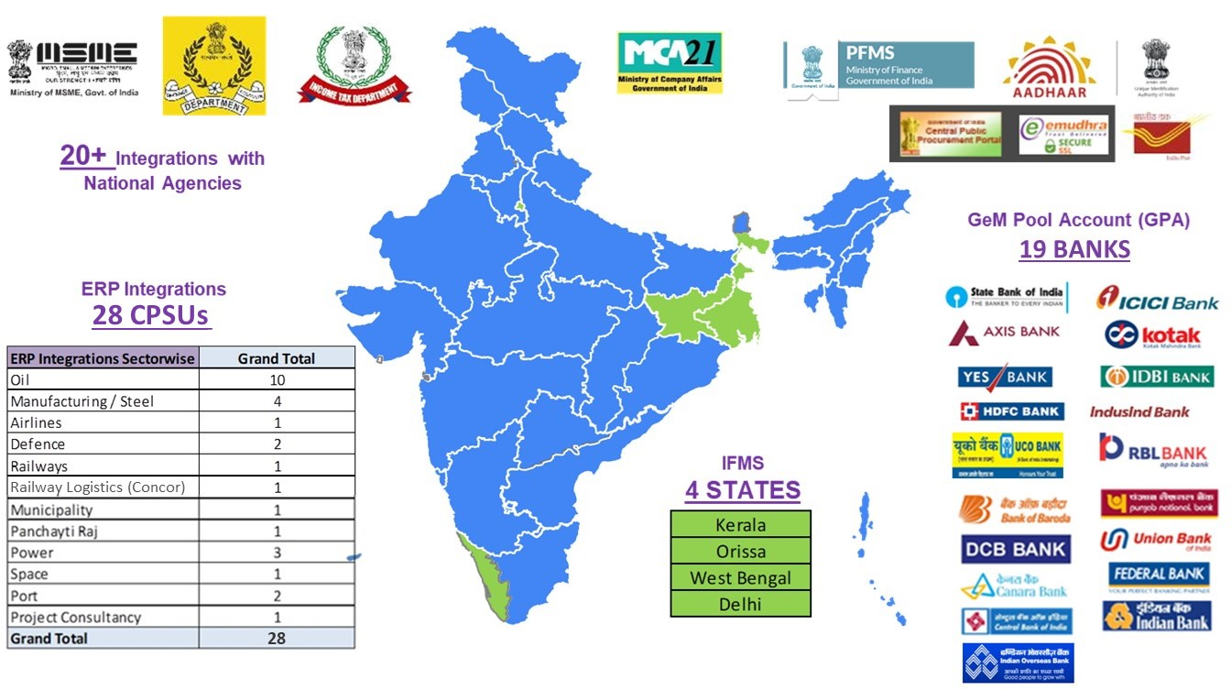
GeM External Integrations

Slide 25
Services | Key Highlights
GeM today is home to 280+ service categories with over 2.75 lakh offerings for catering to all kinds of services procurement in any govt. department
Specialized service categories like Drone Hiring, Hiring of Electric Vehicles, Cash Management, Hiring of Chartered Aircrafts, Insurance, Coal Overburden and extraction are available on GeM
Ash & Coal Transportation Bids worth more than ₹ 1800 Cr published by NTPC
Insurance Services bids of ~ ₹ 1700 crore placed through GeM
Hiring of Chartered Aircrafts – 830 Aircraft hired by Indian Army, with an order value of ~ ₹ 143 Cr
Manpower Outsourcing services more than worth ₹ 12,000 crore procured through GeM in current FY
Bid worth ₹ 1000 Cr published by Canara Bank for hiring of System Integrator for Core Banking Solution
Bid worth ₹ 949 Cr published by UP Govt. for hiring of Master System Integrator for UP112 Project

Slide 26
GeM has been reimagining India’s public procurement via technology, analytics & process digitization
1
2
3
4
Cost Savings
Time Efficiency
Reach & Inclusiveness
Transparency & Fairness
Reverse auction: ~25% price reduction vs avg. original L1 price
Guaranteed discounts via direct OEM deals
Demand aggregation
Approx. 10% savings est. FY21-22¹
Tender cycle time reduced from 34 to 24 days²
Standard templates e.g., bid forms, T&Cs
Fast track procurement e.g., DP upto INR 25K
On-time delivery up from ~80% to ~97% - for orders paid on GeM
MSE share >55% of annual GMV since 2016
> 8 lakh MSE sellers
>1.3 lakh Women,
>39K SC / ST sellers
GeM Sahay: Instant order -based loans to sellers
Microportals: Startup Runway, TRIBESINDIA e-store
Contract data made available in the public domain
Seller representation window to challenge disqualification
Transparent authentication through e-sign and DSC
Multiple studies including World Bank, National Economic Survey and GeM internal study based on mandatory discounts, RA price reduction, select sample price comparison with other ecommerce and bid data reported by buyers
Comparison of "Bid start" to "Bid close" dates of 704 GeM and out-of-GeM transactions; data reported by buyers

Slide 27
Cost Savings on GeM
An independent study conducted by the World Bank and IIM Lucknow in 2020 estimated an average 9.75% savings from the median price.
The World Bank also noted that with every increase in bidder, there was an increase in savings of 0.55%.
The Economic Survey 2021-22 highlighted a cost comparison for 22 common-use goods listed on GeM versus listings on popular online platforms like Amazon and Flipkart.
Prices on GeM were observed to be 9.5% lower in comparison with other online platforms for 10 out of 22 commodities.
GeM also commissioned a study done by Boston Consulting Group (BCG), where the annual cost savings in FY22 were estimated to be in the range of 8-11%.
Considering the above estimates, GeM has facilitated cost savings of more than ₹ 35,000 crore for the government since its inception.
Major reasons: Higher seller participation, information symmetry and availability, bulk discounts, better price discovery functionalities such as reverse auction and demand aggregation

Slide 28
Transparency on GeM
Data (incl. price, participants) for all* Bids, Reverse Auctions and Contracts made available for public viewing on the Home page
GeM has introduced the feature of tracking Business opportunity in public procurement at the category level
Seller, OEM and Catalogue count available for each category
Comparison of Order value and Order volume in the current year versus last year
List of brands populating the category
Functionality of capturing the annual procurement potential of all buyers on GeM
Buyers can mention their procurement plan for the upcoming Financial Year
Demarcation for GeMmable vs non-GeMmable procurement
GeM to concentrate efforts to improve GeM Utilization Ratio in close coordination with the buyers
*Except sensitive bid information of Defence procurement

Slide 29
E-Procurement | Bid evaluation and awarding - Technical & Financial (I/II)
Technical evaluator
Seek clarification
Buyers to seek clarifications regarding uploaded documents from Sellers during technical evaluation
Buyer will be allowed to seek clarification from all sellers as required. Buyer may seek clarifications more than once
Sellers will be allowed a minimum of 48 hours to provide clarifications. The time provided to all sellers will be the same as defined by the buyer subject to a minimum of 48 hours
MSE/MII verifications
Technical Evaluation results along with reason

Slide 30
E-Procurement | Bid evaluation and awarding - Technical & Financial (II/II)
Challenge Rejection
If the Buyer seeks clarification from any of the sellers, the technical qualification will be frozen for these sellers until the clarifications are obtained from the sellers (in the 48 hours duration or as per time specified by the buyer).
Allow sellers 48 hours post completion of technical evaluation to make any representations against disqualifications.
Buyer will have an option to Bypass the Challenge Rejection buffer time i.e., 48 hours, only in bids which have duration less than 10 days by submitting undertaking
Faceless Online L1 Negotiations
System driven splitting for MII and MSE

Slide 31
Findings from a study undertaken by BCG (during end 2021) on feedback from stakeholders, cost savings and measures to enhance TRUST on the portal
Buyer and Seller satisfaction scores were 59% and 56%: measures initiated to raise score to 80% (excellent by industry standards)over next 2 years
Overall sentiment analysis for GeM was -3.9% , much better as compared to -14.5% for IRCTC, -20.1% for Flipkart,-13.6% for Amazon . Positive themes for GeM include focus on transparency, efficiency and inclusivity and negative ones include fake websites, pricing and occasional quality issues.
Measures initiated on all recommendations for enhancing Trust: Measures relate to Customer promise, Strengthening internal control measures, enhancing competence & Education and sensitization
Some such measures include:
AI/ML based use case-based platform level controls- Development complete, to be rolled out in phases from 01.04.23
Help Desk strengthened
Separate vertical being established for Risk and Fraud assessment, monitoring and reporting - RfP floated, work to be started by end of May 2023
Annual External Audit : RfP being floated for a fresh Audit to assess impact of the portal- SWOT and recommendations to enhance Effectiveness, Trust and Integrity.

Slide 32
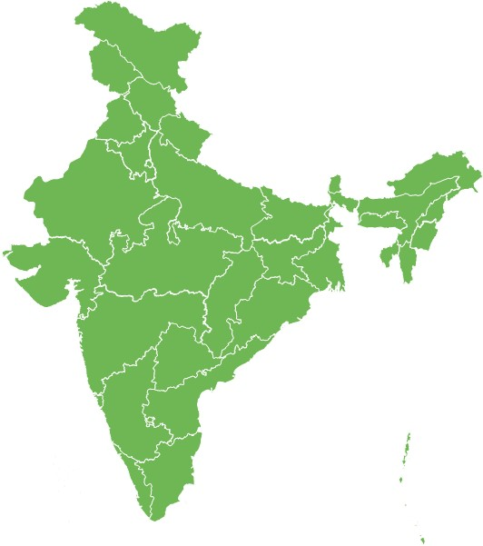
Multiple initiatives currently in progress to unlock the next wave of growth at GeM
Key growth vectors
Key enablers
Technology investments: scalability & innovation focus (incl. AI-ML)
Revamping key operations: Marketplace sanity, customer care, incidents
Large scale Open API based integrations
Bringing together all forms of govt. procurement on GeM
Driving grassroot adoption: States, Municipalities, Village Panchayat
Value added services: Fintech, Logistics, Data & analytics

Slide 33
Advanced analytics module being developed to further drive efficiency, inclusivity and transparency on GeM
Modules under implementation:
Market Intelligence
Product Similarity
Price Gap Analysis
Anomaly Detection
Unstructured Data Analysis
Bidding Analytics-Health of a Bid
Key benefits envisaged:
Empowering buyers to discover the right price for a given product or service
Easier navigation and content design for both buyers and sellers
Near-real-time identification of any abnormal activity between buyers and sellers
High visibility for decision makers to take necessary steps and stop potential collusion practices

Slide 34
Advance Analytics Use Cases (I/III)
S. No. | Use Case | Solution description
1 | Market Intelligence | Create centralized data repository of competitive/ market data of products within GeM for performing competitive analysis and benchmarking prices for reference
2 | Product similarity | Map GeM products with similar products within GeM catalog to identify: 1. Products with comparable features that offer better market value 2. Products with better specification with similar/ acceptable higher price
3 | Govt. Initiative | Map products with similar products within GeM catalog to identify products with comparable features that offer better market value and fulfills conditions of govt. initiatives
4 | Certificate validation | Validation of the data points available in the certificate with the given data of the check points
5 | Demand forecasting | Forecasting demand/ order quantity of the frequently procured categories in GeM
6 | Health of the bid | Creating a report of the bid to assess its competitiveness and fairness

Slide 35
Advance Analytics Use Cases (II/III)
S. No. | Use Case | Solution description
7 | Internal price analysis | Price gap analysis of the Gem product at all four level: 1. Analysis with the similar products available in the GeM platform 2. Analysis with the similar products available in the e marketplace 3. Analysis of the minimum and maximum trend of the product price 4. Analysis of the product price trend to determine the outliers.
8 | External marketplace price analysis
9 | Min-Max analysis
10 | Price Trend Outlier detection
11 | Technical Rejection Comments Appropriateness | Identify vague or irrelevant comments by the buyer for disqualifying sellers during technical evaluation
12 | Technical Rejection Appropriateness | Products and specification comparison of base product versus the product offered in bid

Slide 36
Advance Analytics Use Cases (III/III)
S. No. | Use Case | Solution description
13 | Intentional Hiding of Product | Identify products with unique parameter offering that can help hide a product in plain sight
14 | Buyer-Seller Collusion | Identify transactions that indicates buyer biasing competition in favor of a seller
15 | Avoiding Order Aggregation/Order splitting | Identification of buyers creating multiple orders (Order splitting) that can be clubbed as a single order
16 | Buyer Seller IP Mapping | Identification of bids where seller and buyer use the same IP address to participate and act in a bid respectively
17 | Product Image Deduplication | Validate if catalog images are duplicates, both at catalog creation stage or from the market
18 | Product Image Category Mismatch | Validate if catalog images belong to the selected category, both at catalog creation stage or from the market
19 | Category Feature Relevance | Validate if catalog images corresponds to the features of the selected category, both at catalog creation stage or from the market

Slide 37
Thank You
Leveraging AI/ML & Emerging Technologies across Business Processes
Catalogue management including automatic tagging and text description
Procurement planning, forecasting and monitoring
Intelligent virtual assistant to aid buyer/seller journeys
Market sanity, fraud, and anomaly detection
Sentiment analysis for feedback and mapping feedback to processes
Blockchain-based solution for bulk procurement & smart contracts
Customer mapping, segmentation & behavior prediction
Product recommendation engine including image-based recommendations
Intelligent Search using NLP using Search Module

Slide 38
Social inclusion on GeM

Slide 39
Outreach initiatives
Launch of Common Service Centers (CSCs) & India Posts integration and Seller Samvaad by Hon’ble CIM
Integration with 5.2 lakh+ CSCs and 1.5 lakh+ India Post offices to deliver GeM services to last-mile sellers and service-providers
Training of CSC State Mission Coordinators/ District Managers trained to further train VLEs on GeM buyer and seller registration process and product catalogue upload
Two-week Pan-India seller engagement organized in collaboration with the Press Information Bureau in mid-Sept’ 22 panning across 26 cities
Sellers from MSME, SHGs, Women entrepreneurs, and other marginalized sectors were invited for sharing their experiences, success stories on GeM
FM Radio campaign
Campaign launch with RED FM in 40+ cities for dedicated 30 seconds on highlights and benefits of GeM followed by How to Register on GeM

Slide 40
Top Procuring Central Ministries (including respective CPSEs & allied bodies)
S. No. | Ministry | GeM GMV in FY21-22 (₹ crore) | GeM GMV in FY22-23 till 20th Mar’23 (₹ crore)
1 | Ministry of Power | 3,296 | 26,829
2 | Ministry of Defence | 15,074 | 26,601
3 | Ministry of Petroleum and Natural Gas | 17,443 | 24,948
4 | Ministry of Steel | 6,983 | 11,845
5 | Ministry of Health and Family Welfare | 2,013 | 6,950
Basis absolute GMV

Slide 41
Top Procuring CPSEs
S. No. | CPSE | Ministry | GeM GMV in FY21-22 (₹ crore) | GeM GMV in FY22-23 till 20th Mar’23 (₹ crore)
1 | National Thermal Power Corporation Limited | Ministry of Power | 1,193 | 22,765
2 | Steel Authority of India Limited | Ministry of Steel | 4,616 | 9,001
3 | Indian Oil Corporation Limited | Ministry of Petroleum and Natural Gas | 2,433 | 7,946
4 | Bharat Heavy Electricals Limited | Ministry of Heavy Industries | 3,909 | 6,048
5 | Oil & Natural Gas Corporation Limited | Ministry of Petroleum and Natural Gas | 3,808 | 5,577
Basis absolute GMV

Slide 42
Top Procuring States
S. No. | State | GeM GMV in FY21-22 (₹ crore) | GeM GMV in FY22-23 till 20th Mar’23 (₹ crore)
1 | Uttar Pradesh | 11,220 | 10,527
2 | Gujarat | 3,486 | 7,286
3 | Maharashtra | 2,256 | 3,684
4 | Madhya Pradesh | 1,968 | 1,904
5 | Jammu & Kashmir | 1,398 | 1,796
Basis absolute GMV

Slide 43
E-Procurement | Bid evaluation and awarding - Technical & Financial (I/II)
Technical evaluator
Seek clarification
Buyers to seek clarifications regarding uploaded documents from Sellers during technical evaluation
Buyer will be allowed to seek clarification from all sellers as required. Buyer may seek clarifications more than once
Sellers will be allowed a minimum of 48 hours to provide clarifications. The time provided to all sellers will be the same as defined by the buyer subject to a minimum of 48 hours
MSE/MII verifications
Technical Evaluation results along with reason

Slide 44
E-Procurement | Bid evaluation and awarding - Technical & Financial (II/II)
Challenge Rejection
If the Buyer seeks clarification from any of the sellers, the technical qualification will be frozen for these sellers until the clarifications are obtained from the sellers (in the 48 hours duration or as per time specified by the buyer).
Allow sellers 48 hours post completion of technical evaluation to make any representations against disqualifications.
Buyer will have an option to Bypass the Challenge Rejection buffer time i.e., 48 hours, only in bids which have duration less than 10 days by submitting undertaking
Faceless Online L1 Negotiations
System driven splitting for MII and MSE

Slide 45
E-Procurement | Services Categories on GeM (I/III)
1
Manpower Based Services Fixed Remuneration, Minimum Wages, Security Manpower Hiring Service Vehicle/Ambulance Hiring Services – can be procured on rental/leasing basis Cab and Taxi Hiring; Ambulance Hiring; Air Ambulance services; Leasing of electric vehicles Facility Management Services - Loans, insurance, assets, investment opportunities Facility Management Service - Manpower and Outcome based, Horticulture Service - Manpower and Outcome based Canteen service, Waste management Cleaning, Sanitation and Disinfection Service - Outcome Based Packaged drinking water service Technology and IT based Services Milestone-based IT projects - Technologies such as AI/ML, Blockchain etc can be procured
2
The Direct Purchase of a product can be done once in a week by buyer except covid categories.
The 25K limit is overruled in Automobile and some Drugs categories.
3
4

Slide 46
E-Procurement | Services Categories on GeM (II/III)
5
Consultancy Services Professional advice for management, engineering, finance, etc. Hiring of Consultants, Hiring of Consultant for Energy Efficiency Services, Hiring of Multimedia Creative Consultants. Logistics Services Goods transport services – per km based, per MT per km based, per trip based, per MT based etc; Air/ Sea international logistics; Domestic Logistics by Air, Surface and Water Entertainment & Media Services – can be procured on rental/leasing basis Advertisement service – newspaper, magazine, Hiring of creative agency etc. Financial Services - loans, insurance, assets, investment opportunities Financial Audit, Asset Management, Insurance service etc Healthcare Services Healthcare human resources outsource service, Healthcare and kitchen and dietary services, Laundry service – Healthcare purpose, Renting of Health ATM/Kiosk, Tele-health services, Liquid Oxygen Service Environment Preservation Services Afforestation service, Conservation of water
6
The Direct Purchase of a product can be done once in a week by buyer except covid categories.
The 25K limit is overruled in Automobile and some Drugs categories.
7
8
9
10

Slide 47
E-Procurement | Services Categories on GeM (III/III)
11
Operation & Maintenance/Annual Maintenance Services O&M of DG Set, Effluent/Sewage Treatment Plant, Powerhouse Equipment Operation and Maintenance of HVAC System, Firefighting System, Fire Alarm System, Lifts & Escalators AMC / CMC of Fire Fighting Equipment, Networking Devices, HVAC Equipment, Renewable Energy Power Plant Insurance Services Assets Insurance Service, Group Mediclaim Insurance Service, Group Term Insurance Service, Group Personal Accident Insurance Service, Overseas Travel and Mediclaim Insurance Services, Motor Insurance Services. Leasing Services Leasing in of Assets, Commercial Properties, Residential Properties, DG sets Specialized Equipment Hiring Services Hiring of chartered aircrafts, special purpose machines, earth moving equipment, material handling equipment and cranes, mining machineries
The Direct Purchase of a product can be done once in a week by buyer except covid categories.
The 25K limit is overruled in Automobile and some Drugs categories.
12
13
14

Slide 48
E-Procurement | Service Development Process
Collection and examination of tenders/contracts issued by diverse buyer groups
Buyers can request for creation of new service on GeM
Post internal analysis and research, if acceptable, service is taken up for development
Outreach to buyers and sellers (CCM) to understand the scope and desired user experience from the service
Detailed research followed by development and internal testing is carried out
Service is made live for sellers first and after market population and subsequently made live for buyers
The Direct Purchase of a product can be done once in a week by buyer except covid categories.
The 25K limit is overruled in Automobile and some Drugs categories.

Slide 49
E-Procurement | Bid Creation Process for Services
Buyer can search and choose the desired service
Buyer can choose from available filters which are unique for a given service
Consignee location can be chosen
Post filter selection, service providers fulfilling the parameters are listed. The price calculation formula can be previewed
Option for giving preference for MSMEs can be selected
Submission of relevant certificates can be made mandatory
Bunch of relevant services can be done in a bid
Any additional documents such as ‘scope of work’, ‘Payment Terms’, ‘additional SLAs’ can be included in the final bid to express exclusive requirements and expectations
Bid Evaluation Methods: Least Cost Selection (LCS), Quality and cost-based selection (QCBS) and L1 mode of purchase
Buyers also specify the ‘Technical qualification’ parameters along with qualifying cut-off
Bid draft can be saved and bid document can be downloaded for review post which bid can be successfully published
The Direct Purchase of a product can be done once in a week by buyer except covid categories.
The 25K limit is overruled in Automobile and some Drugs categories.

Slide 50
Customer Helpdesk | Overview
1
Parameter | Details
# of Contact Centres | 2 centres – Bhopal and Delhi (Escalation and L1/L2 is based on-shore)
No. of Seats | ~200 agent staff operational currently across shifts (including L0, Escalation, L1 and L2 levels and outbound calling)
Languages supported | English, Hindi, Telegu, Tamil, Kannada, Malyalam, Marathi, Bengali, Oriya, Punjabi, and Gujarati
Operations | 6 days in a week (Monday – Saturday) Daily timings: 9:00 AM to 10:00 PM
Accessibility | Toll Free numbers - 18004193436, 18001023436
Channels enabled | Calls, Emails, Chat, Website and Walk-ins
Support provided at customer helpdesk | Queries, Troubleshooting, Technical and Development Support
Governance & audit | Regular performance checks - Weekly, Monthly and Quarterly reviews

Slide 51
Customer Helpdesk | Key interventions in pipeline
1
Addition of Whatsapp channel for communication with buyers and sellers
Automation of call-types to self service mode
Welcome calls to new onboarded buyers
Improving user experience of "Ticket Status view" dashboard on GeM website
Preferential treatment / services for High net-worth Buyers (HNB)

Slide 52
GeM Scale | Transactional & Operational
GeM receives up to 35,000 transactional queries per second
GeM supports over 50,000 documents per day that are digitally or electronically signed.
GeM handles over 1000 user authentication requests and over 250 OTP validations per minute.
Every year, more than 1.5 million calls arrive at the contact center, resulting in 1.2 million CRM tickets.
Every month, 18 million emails and over 10 million messages are sent.
Over 2.5 million product/ brand approval requests received, with an average disposal TAT of 1.13 days.
GeM’s Home page and Contact Center support 12 Indian languages.

