Slide 1
Digitalization of Supply Chain Management On Indian Railways
An Overview
Rajesh Abrol
General Manager/ EPS/Spl. Projects
Centre for Railway Information Systems

Slide 2
About CRIS (Centre for Railway Information Systems)
A Society formed in 1986 under Ministry of Railways, Registered under Societies Act
Functions on No Profit No Loss basis
IT arm of Indian Railways
Indian Railways E-Procurement System (IREPS), Integrated Materials Management System (IMMS)
Passenger Reservation System (PRS), Unreserved Ticketing System (UTS), Freight Operations Information System (FOIS), Control Office Applications (COA), Crew Management System (CMS), Loco Management System (LMS), Integrated Coach Management System (ICMS), Parcel Management System (PMS), Real Time Information System (RTIS)
Human Resources Management System (HRMS)
Accounting Information Management System (AIMS)
Workshop Information Management System (WISE)
Critical applications that impact every aspect of Railways, and public at large

Slide 3
Indian Railways E-Procurement System … since 2008
URL: www.ireps.gov.in

Slide 4
IREPS Portal Offerings
E-Tendering
Procurement of Goods, Services & Works
Leasing of Assets & Services
Vendor Approvals
Demand, Contract, Inventory Management
Third Party Inspections
Sale of Unserviceable Goods / Assets
Consignee Stock Ledgers & Material Handling
E-Reverse Auction
E-Forward Auction
Online Workflows
Digital Certificates
Cloud, DR, AI

Slide 5
Progress Over the Years
Tenders
Count – 34.02 Lacs
Value – 14.46 Lac Crores
Auctions (Sale)
Lots Count – 2.97 Lacs
Value – 31,694 Crores
Auction (Leasing)
Lots Count – 5900
Value – 3300 Crores
Tender Decision
Lots Count – 13.20 Lacs
Value – 4.65 Lac Crores
Receipts / Issues
Count – 4.04 Crores
Value – 5.78 Lac Crores

Slide 6
Salient Features
PKI Enabled
Digital Encryption of Bids
Digital Signing of Data and PDFs
Digitized Item Directories
Schedule of Rates (Centralized / Local)
Item Masters
Digital Repositories
for Tender / Contract Conditions
for Documents
SMS & E-Mail Alerts
For Tender Publishing, RA, Tender Decision, Ordering etc.

Slide 7
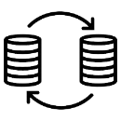
Salient Features
Compliances
Make in India Policy, MSE Policy, Startup Policy, Railway Board Instructions
Integrations
Payment Gateways- SBI Net banking, SBIePay (Multi-Bank, Credit/ Debit Card), Lien Marking, VAN
GeM, RITES, CPPP, RDSO, IPAS, PUs, IRPSM etc.
Helpdesk Support
Web-query
Telephonic
Learning Centre
Trial Website
User Manuals

Slide 8
Supply Chain

Slide 9
Computerization Vs. Digital Transformation
Business Process Reengineering
Computerization without Business Process Re-engineering is a farce
Automation
Anything & everything that can be done by the system, shouldn’t be done by people. Automation is core requirement of Digital Transformation
Process Flows
Data shall be generated through process flows, not data entry, to the extent possible
Data Duplication
Data already available in the system shall never be reentered

Slide 10
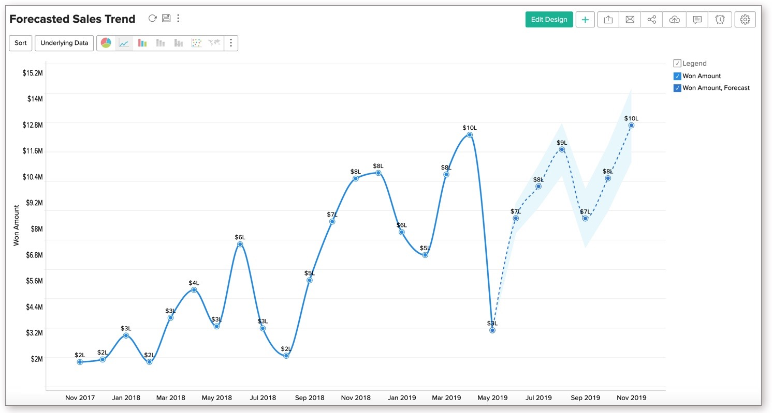
Pre-Tender Activities
Demand Projection / Creation
Regular (Revenue / Capital)(Automatic)
Special
Emergency
Demand Aggregation
Clubbing of Similar Demands
Purchase Approvals
Approval Workflows
Schedule of Powers
Versioning

Slide 11
Tendering
Creation of Tender Document
Approvals (online workflows)
Tender Publishing
Corrigenda
Submission of Earnest Money
Online / Manual/ Exemptions
Submission of Encrypted Bids
Revision of Bids
Tender Opening
Auto Generation of Tabulations
Financial / Techno-Commercial

Slide 12
Tender Decision
Online Scheduling of Meetings
Assisted Preparation of Tender Committee Minutes (TCM)
Secretarial Assistance – For Preparing Draft TCM
Online clarifications from Vendors
Online Acceptance/ Rejection of TCR
Issue & Acceptance of Counteroffer
Calling of Negotiations, Revised of Bid
Auto Generation of Letter of Acceptance

Slide 13
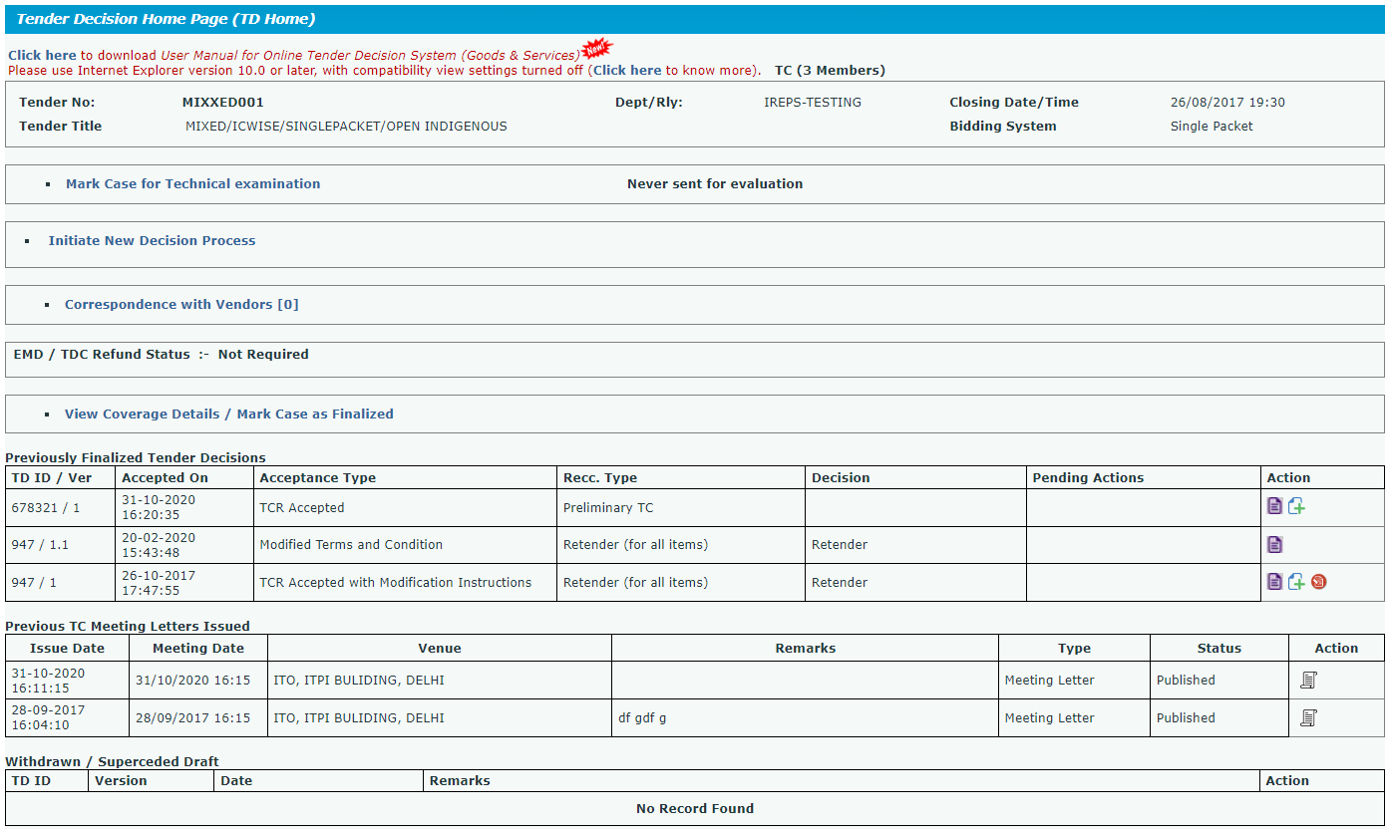

Slide 14
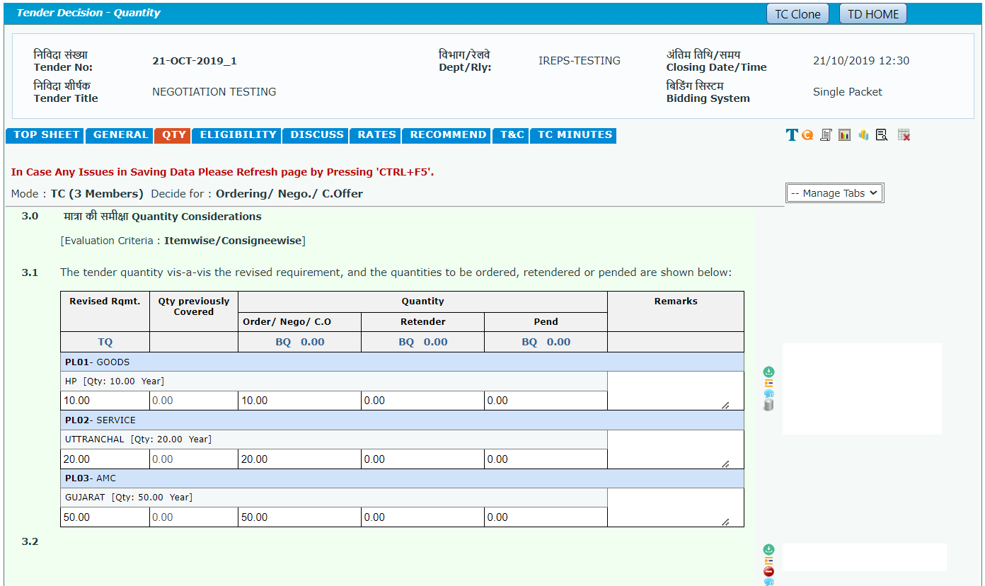

Slide 15
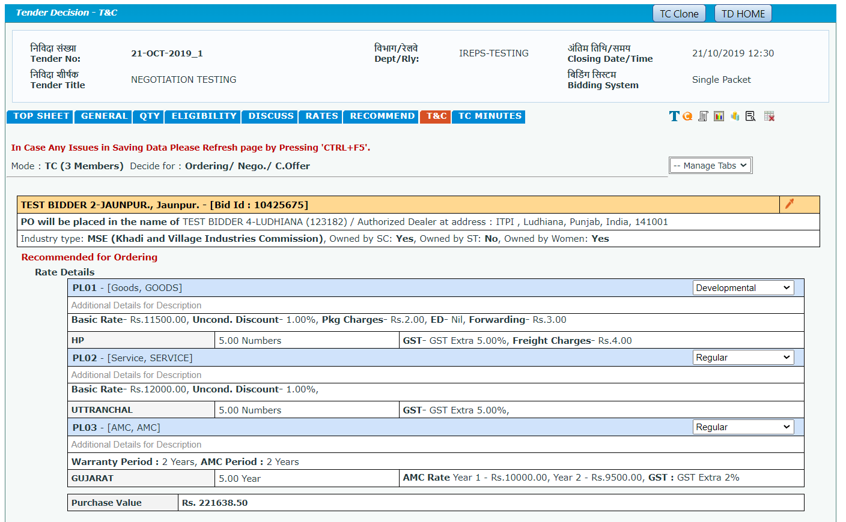

Slide 16
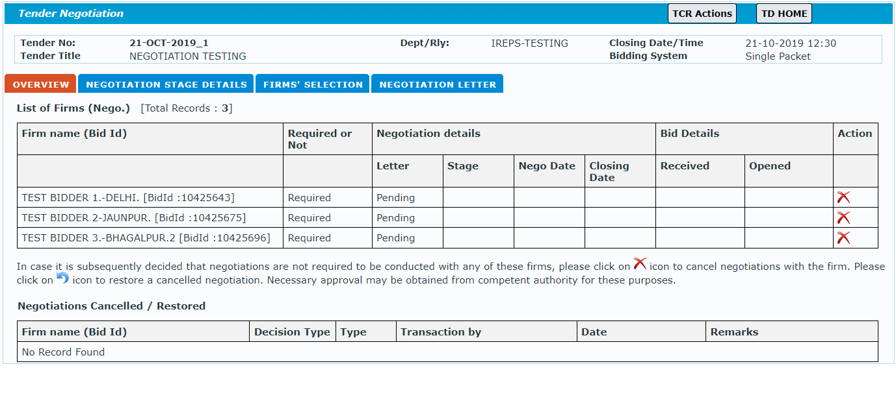

Slide 17
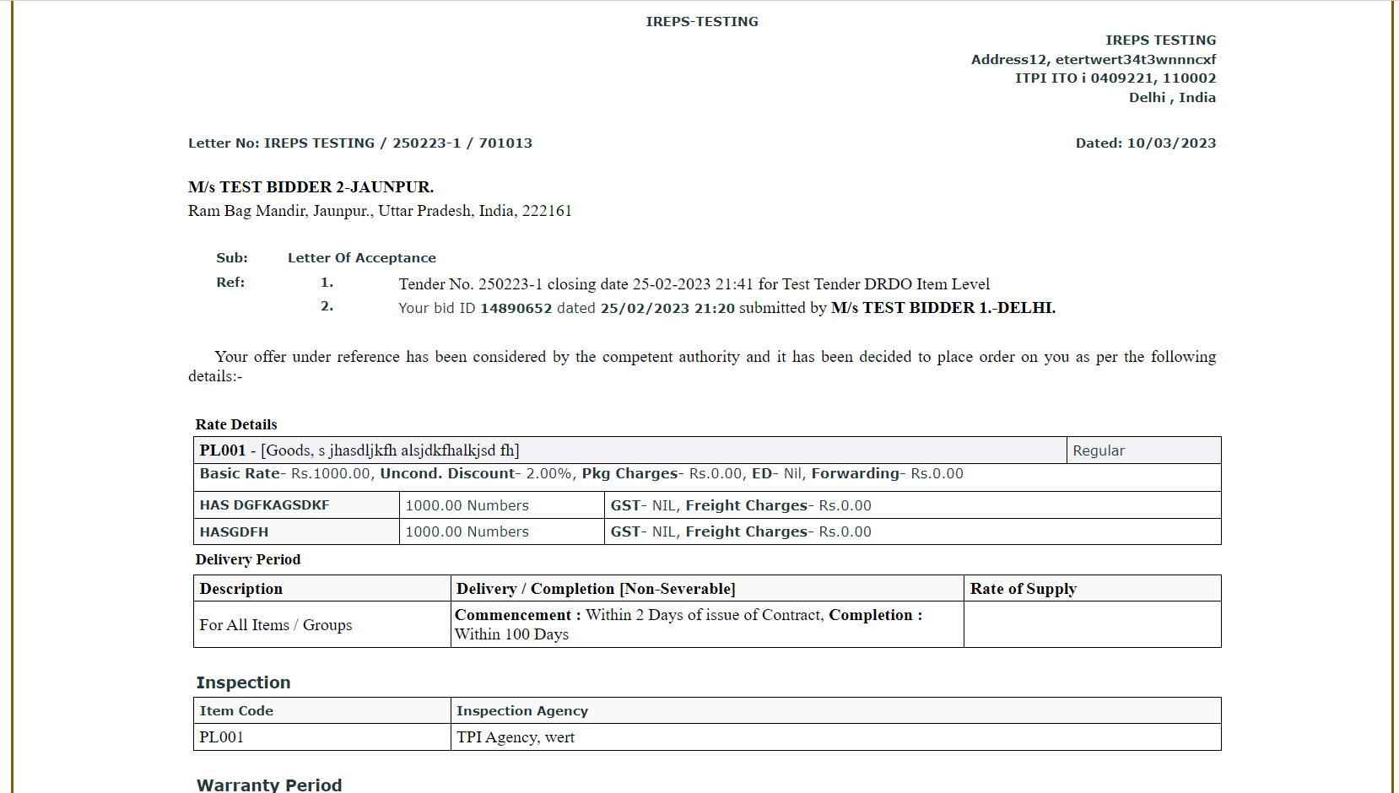

Slide 18
Contract Management
Auto Generation of Contract
Funds Management
Online Requests for Modifications
Contract Modifications
Submission of Dispatch Particulars (by vendor)
Delivery of Materials
Acceptance / Rejection of Materials

Slide 19
Bill Payments
Online submission of Bill
Finance Payment Bill
Advance Payment Bill
Supplementary Bill
Bill Passing by Accounts department
Return of Bills, Resubmission of Bills
Online bill status to vendors
Online Payments

Slide 20
Other Supply Related Activities
Third Party Inspections
Approval of Vendors
Capacity / Capability Assessment
Item-wise list of Approved Vendors
Warranty Management
Funds Management

Slide 21
Inventory Management
Stocking of Materials
ASRS Systems
Issue of Materials
FIFO, Shelf life, Traceability
Returned Stores
Disposal of unserviceable materials

Slide 22
Way Forward
Vendor Managed Inventory
Logistics Portal
Auto Payment
Pre-Qualification → Post Facto Verification
Data Analytics

Slide 23
Thank You

